Slide 1
Oestrus sp., Hypoderma bovis
Myiasis:
Practical Parasitology
3rd Class
Prof. Dr. Muna M. Jori

Slide 2
A

Slide 3
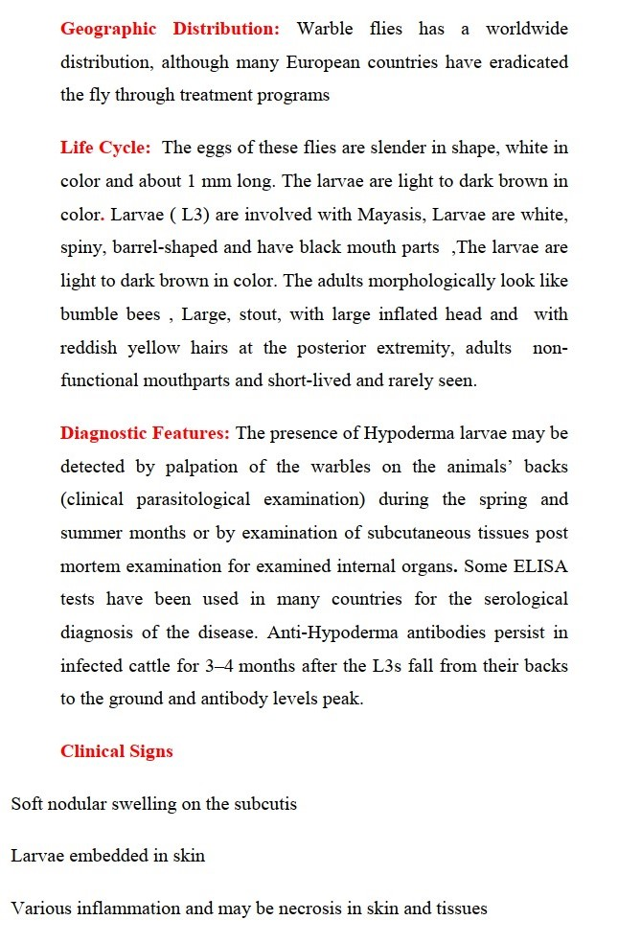
Primary goals
Annual revenue growth

Slide 4
Quarterly performance

Slide 5
Areas of growth

Slide 6
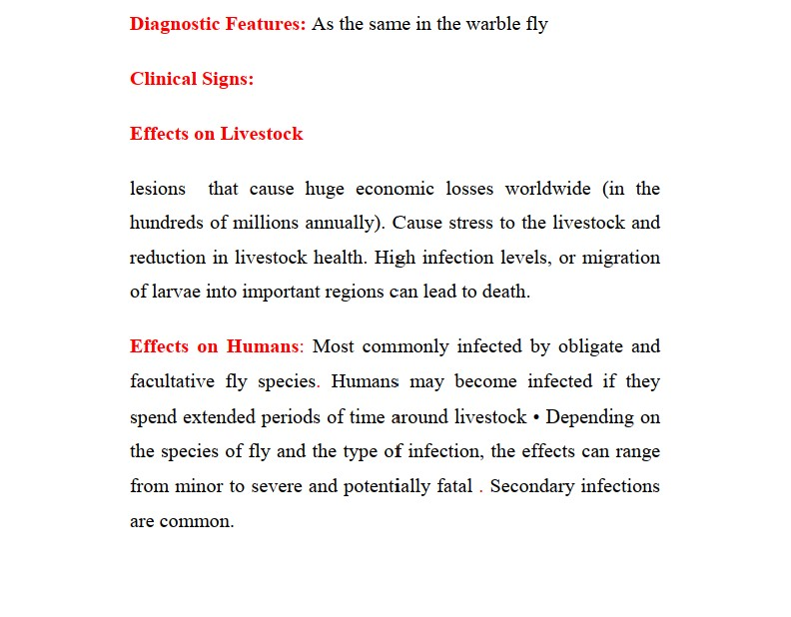
“
”
Richard Branson

Slide 7
Thank you
DR. Muna M. Jori

